Slide 1
CS213 – 2022 / 2023
Programming II
Lecture 9: OOP – VI
Slicing, Pointers to Objects,
Object Arrays and OOP Modeling
Cairo University, Faculty of Computers and AI
By
Dr. Mohammad El-Ramly

Slide 2
Lecture Objectives
Slicing
Pointers to Objects
Arrays of Objects
OOP Modeling Example

Slide 3
Assignment 2

Slide 4
See this link on Polymorphism
https://www.geeksforgeeks.org/cpp-polymorphism/

Slide 5
What is this course about?
Advance your general programming skills
Learn advanced OO and C++ techniques
Topics
  Review of C++ basics 1 w
  Object-oriented programming 4 w
    Basics of OO: objects, classes and data abstraction
    OO program design and modeling
    Inheritance, abstraction, polymorphism, overloading,
  Generic programming in C++ (templates) 1 w
  Recursion and backtracking 1 w
  Exception handling 1 w
  Standard template Library (STL) 1 w
  Advanced concepts 2 w

Slide 6
1. Object Slicing
In C++ programming, object slicing occurs when an object of a subclass type is copied to an object of superclass type.
The superclass copy will not have any of the member variables defined in the subclass. These variables have, in effect, been "sliced off".

Slide 7
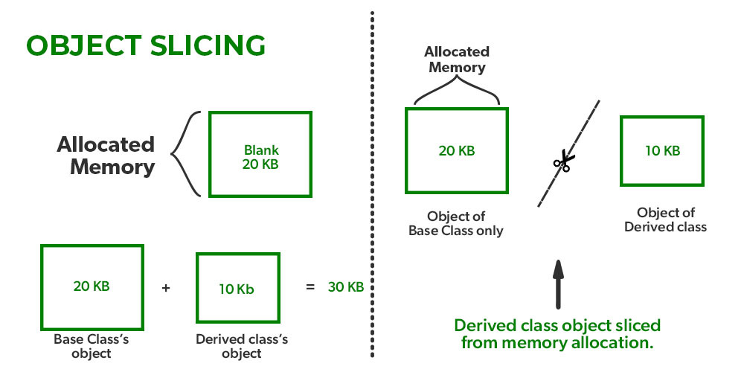
Object Slicing

Slide 8
Object Slicing
class Base {
protected:
int i;
public:
Base(int a): i(a) {}
virtual void display() {
cout << "Base object, i = " << i << endl;
}
};
class Derived : public Base {
int j;
public:
Derived(int a, int b): Base(a), j(b) {}
virtual void display() {
cout << "Derived object, i = " << i
<< ", j = " << j << endl;
}
};

Slide 9
Object Slicing
// Pass Base object by value or reference
void somefunc(Base& obj) {obj.display();}
int main()
{
Base b(33);
Base d = Derived (45, 54);
b.display(); // Base print
d.display(); // Base print
somefunc(b); // Also, Base print
somefunc(d); // And Base print
return 0;
}

Slide 11
2. Pointers to Objects
Pointers can point to objects:
  MyClass{
  public:
  int get() const {return d_;}; //cannot change class data
  void set(int d){d_= d;};
  private:
  int d_;
  };
  MyClass ob, *obp = &ob;
Members can be accessed using pointers:
  (*obp).set(5);
Parentheses around (*obp) are needed because dot-operator has higher precedence than dereferencing
A shorthand -> is used for accessing members of the object the pointer points to:
  cout << obp -> get();

Slide 12
Member instances vs.member pointers to instances
Which is better?
  In general use class instances as members - restricts flexibility but offers more protection against error
    Because the compiler automatically constructs and destroys class instance members.
    Copies them on assignment and initialisation.
    If the member instance is private, access is limited to members functions and friend functions
  Using member pointers requires more effort on the part of the programmer and caution about errors
    You must remember to explicitly construct and destroy the referenced object and initialise the pointer to it.

Slide 13
The this pointer
Instances of a class each have their own private data
For practical reasons there is only a single copy of the class functions which are shared by all the instances.
So how do the member function access the correct object?
  Answer- using a pointer to the object
The pointer is called this and is automatically passed to the function by the compiler.
The this pointer is used to access the member data. E.g. this->data_item

Slide 14
The this pointer
Example
Patient x;
x.set_age(arg); //Compiler makes
// it set_age(&x,arg);
Every member function has a hidden argument
void Patient::set_age(Patient* this, int a)
the data of instance x is accessed via the this pointer so when the programmer has written
age = a; // the compiler actually uses this->age = a;

Slide 15
The this pointer
Normally we can ignore the this pointer unless:
  We want access to the invoking instance within a member function like a constructor.
    this -> sign = sign;
  *this de-references the pointer and refer to the actual object, usually in a return statement like in assignment operator.
    return *this;

Slide 17
3. Arrays of Objects
Objects can be the elements of an array:
  InventoryItem inventory[40];
Default constructor for object is used when array is defined

Slide 18
Arrays of Objects
Must use initializer list to invoke constructor that takes arguments:
  InventoryItem inventory[3] =
  {"Hammer", "Wrench", "Pliers"};

Slide 19

Arrays of Objects
If the constructor requires more than one argument, the initializer must take the form of a function call:

Slide 20

Arrays of Objects
It isn't necessary to call the same constructor for each object in an array:

Slide 21
Accessing Objects in an Array
Objects in an array are referenced using subscripts
Member functions are referenced using dot notation:
  inventory[2].setUnits(30);
  cout << inventory[2].getUnits();

Slide 22
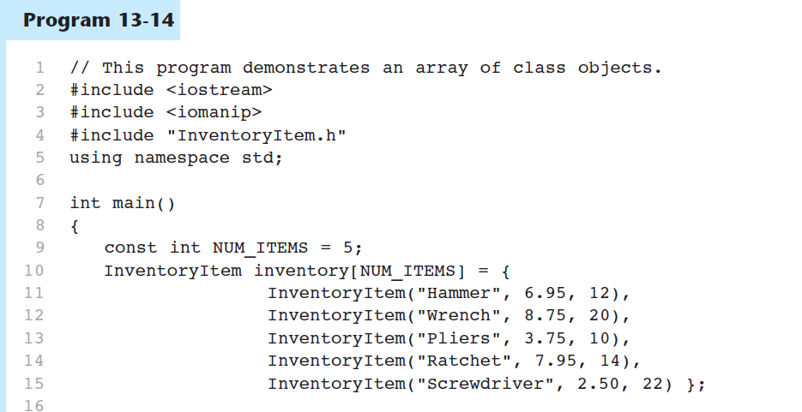

Slide 23
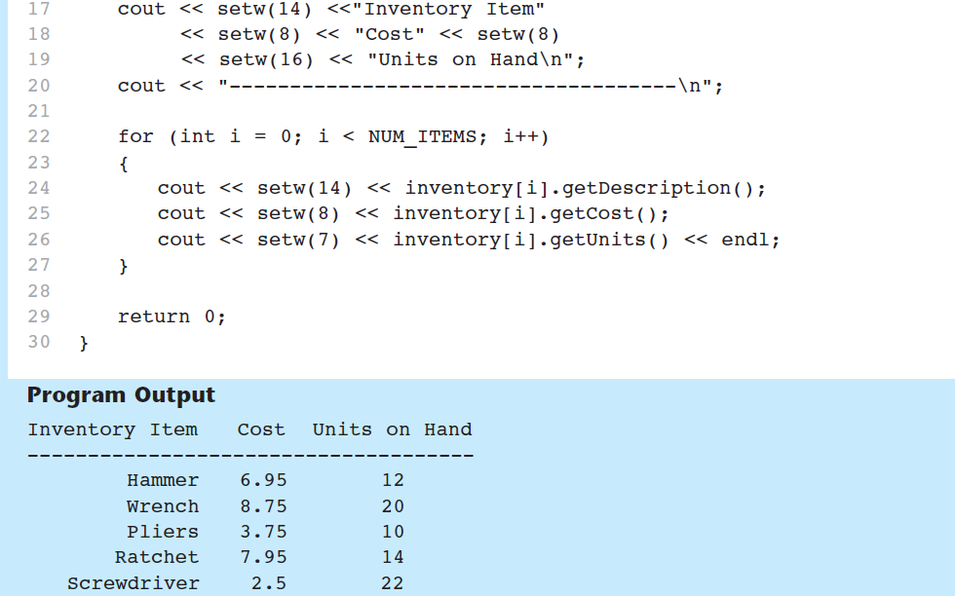
Program 13-14 (Continued)

Slide 25
Dynamic Arrays of Objects
Like any other type, you can make a pointer that points to a single object or an array of objects (dynamically allocated with new operators)
You need to use delete or delete [] in the destructor
  Animal* an_animal = new Cat();
  // Will see only Animal parts
  an_animal -> meow(); // WILL NOT WORK
  ((cat*)an_animal) -> meow();// WORKS

Slide 26
Base Pointer to Derived Class
  Animal* an_animal = new Cat();
in
stack
an_animal
Animal*
☻
Cat Object
Animal Part
Cat Part
in
heap

Slide 27
Base Pointer to Derived Class
  Animal* an_animal = new Cat();
  ((cat*)an_animal) -> meow();
in
stack
an_animal
(Cat*)
☻
Cat Object
Animal Part
Cat Part
in
heap

Slide 28
Five ways to create dynamic arrays of objects
Using new operator
Using malloc()
Using an array of pointers
Using a pointer to pointers
Using vector<T>

Slide 29


I. Using new operator
  // Array of dynamic objects of
  // equal size and default constructor
  Animal* animals = new animals[4];
  for (int i = 0; i < 4; i++)
  animals[i].eat();
  for (int i = 0; i < 4; i++)
  (animals + i) -> eat();
  delete[] animals;
in
stack
animals
☻
in
heap

Slide 30
What is the problem with this code?
// meow exists in Cat and not
// in Animal
Animal* cats = new Cat[2];
cats[1].meow(); // Wrong
// Animal pointer sees only
// parts of Animal in Cat

Slide 31
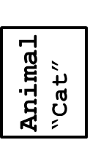
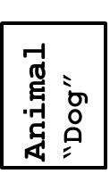
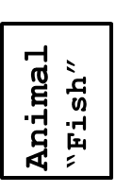
II. Using malloc()
  // Allocate a block of memory
  // Can call parameterized constructors
  Animal* a = (Animal*) malloc
  (sizeof(Animal) * 3);
  a[0] = Animal("Cat");
  a[1] = Animal("Dog");
  a[2] = Animal("Fish");
  free(a);
in
stack
a
☻
in
heap

Slide 32


III. Using an array of pointers
  // Array of pointers to parent. Each
  // pointer points to any type of child
  Animal* animals[] =
  {new Animal("animal"),
  new Cat("cat"),
  new Dog("dog")};
  for (int i = 0; i < 3; i++)
  animals[i] -> eat();
  for (int i = 0; i < 3; i++)
  delete animals[i];
animals
☻
Animal
Cat
Dog
in
stack
in
heap

Slide 33
VI. Using a pointer to pointers
  // Pointer to pointers to parent. Each
  // pointer points to any type of child
  Animal** animals = new Animal*[3];
  animals[0] = new Animal("animal");
  animals[1] = new Cat("cat");
  animals[2] = new Dog("dog");
  for (int i = 0; i < 3; i++)
  animals[i] -> eat();
  for (int i = 0; i < 3; i++)
  delete animals[i];
  delete[] animals;
animals
☻
Animal
Cat
Dog
in
heap
in
heap

Slide 34
V. Using vector<T>
  // Using vector in STL
  vector<Animal> v; // Do not do vector<A> v(3)
  v.reserve(3);
  v.push_back(Animal("animal"));
  v.push_back(Cat("cat"));
  v.push_back(Dog("dog"));
  // Slicing problem
  // Will see only animal part

Slide 36
4. The Unified Modeling Language

Slide 37
The Unified Modeling Language
UML stands for Unified Modeling Language.
The UML provides a set of standard diagrams for graphically depicting object-oriented systems
  Use case diagram
  Class diagram
  Sequence diagram

Slide 38
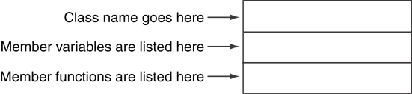
UML Class Diagram
A UML diagram for a class has three main sections.

Slide 39
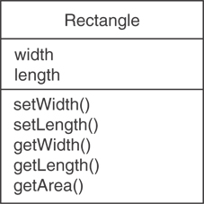
Example: A Rectangle Class
class Rectangle
{
private:
double width;
double length;
public:
bool setWidth(double);
bool setLength(double);
double getWidth() const;
double getLength() const;
double getArea() const;
};

Slide 40
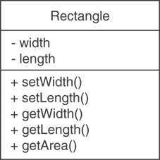
UML Access Specification Notation
In UML you indicate a private member with a minus (-), protected with (#) and a public with a plus(+).
These member variables are private.
These member functions are public.

Slide 41
UML Data Type Notation
To indicate the data type of a member variable, place a colon followed by the name of the data type after the name of the variable.
# is protected
# width : double
# length : double

Slide 42
UML Parameter Type Notation
To indicate the data type of a function’s parameter variable, place a colon followed by the name of the data type after the name of the variable.
+ setWidth(w : double)

Slide 43
UML Function Return Type Notation
To indicate the data type of a function’s return value, place a colon followed by the name of the data type after the function’s parameter list.
+ setWidth(w : double) : void

Slide 44
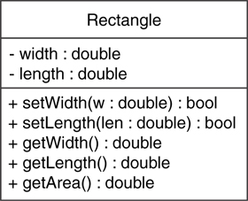
The Rectangle Class

Slide 45
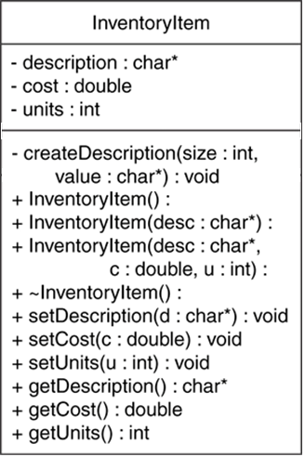
Showing Constructors and Destructors
No return type listed for constructors or destructors
Constructors
Destructor

Slide 46
Relations between Classes
Point
Association
Inheritance
Square

Slide 47
Multiplicity of Association
Multiplicity
4
Point
Square

Slide 48
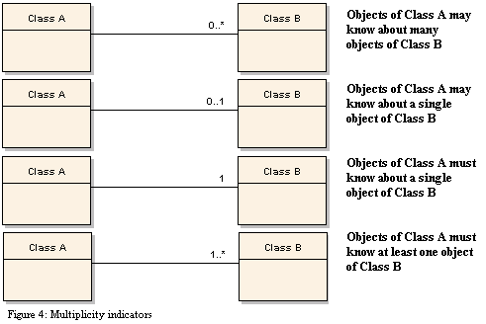
Multiplicity of Association

Slide 49
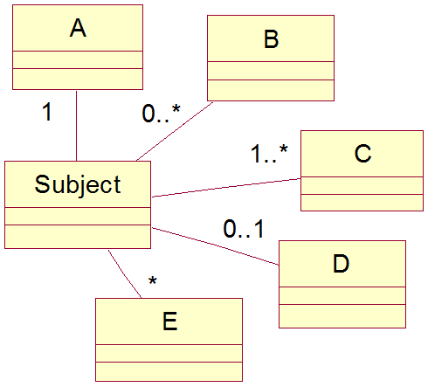
Relations between Classes

Slide 50
OOP Modeling Example
Library System
We like to build a library system
Library has books, each has an id, title & author.
There are regular books and rare books. Rare books مخطوطات و كتب نادرة cannot be borrowed.
There are 2 types of users: Student & Professor. Depending on his type, he is allowed a max number of books to borrow: 2 for student & 4 for professors. A professor can borrow for 4 weeks and a student for 2 weeks.

Slide 51
OOP Modeling Example
Library System
A user is identified by his name and phone.
At start, library data loads existing books and users from files.
The system allows adding a new book or a new user, listing all books or all users, giving a book to a user to borrow or returning it.
At closing, the system stores books and users.
Develop a model for this system using OOP and build it.

Slide 52
https://www.geeksforgeeks.org/copy-constructor-in-cpp/
https://www.softwareideas.net/en/free-uml-tool
https://www.visual-paradigm.com/features/code-engineering-tools/

Slide 53
